Slide 1

Building A Scalable Data Science Platform with R
Presented By:
Yuvarajan v
Research Scholar
Project Assistant(DST)

Slide 2

Agenda
Data analytics
Data analytics vs Data analysis
Introduction to R
Data Manipulation in R
Data visualization in R
Features of R
Data Types and Structures
Types of Data analytics
Applications of R

Slide 3

Data analytics vs Data analysis

Slide 4
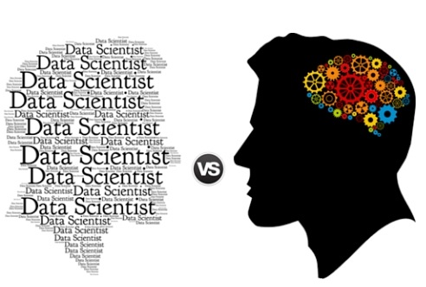
Data Analysis stands for human activities aimed at gaining some insight on a dataset. An analyst can use some Data Analytics tools to obtain desired results, but in principle, Data Analysis can be performed without special data processing
Data Analytics = Data analysis + logic

Slide 5
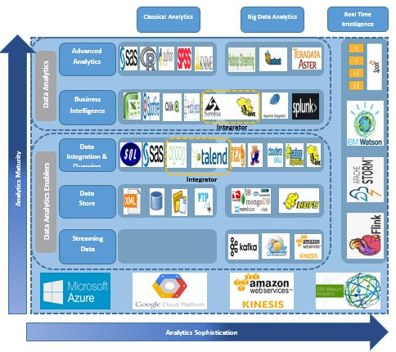
Data Analytics Tools

Slide 6
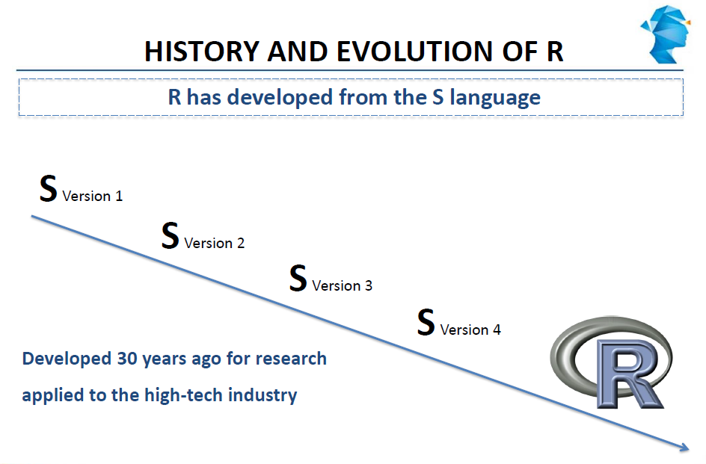
History and Evaluation of R

Slide 7
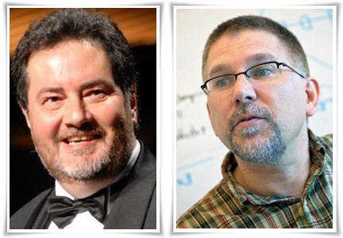
A Brief History R
1993 - Research project in Auckland, NZ
*Ross lhaka and Robert Gentleman
1995 – Released as a open-source software
*Generally compatible with the S language
1997 – R core group formed
2003 – R Foundation formed in Austria
2007 – Revolution analytics founded
2014 – Revolution R open launched
2015 – R consortium founded
2015 – Microsoft acquire Revolution analytics
2018 – 3.4.3 Latest version Released(January)

Slide 8
Introduction of R
R is a free software environment for statistical computing and graphics.
Available freely under the GNU public licence
R provides a wide verity of statistical (linear and nonlinear modelling, Classical statistical test, time series analysis, Classification, Cluster) and graphical techniques and highly extensible.
Very little programming language knowledge necessary
R can be easily extended with 10,000+ packages available on CRAN (as of 2017).
Many other packages provided on Bio conductor, R-Forge, GitHub, etc.
Can be download from http://www.r-project.org/

Slide 9

What is
Language
Platform
The most popular statistical programming language
A data visualization tool
Open source
Community
2.5+M users
Taught in most universities
New and recent grad’s use it
Thriving user groups worldwide
Ecosystem
10,000+ contributed packages
Rich application & platform integration
Notes:
9

Slide 10
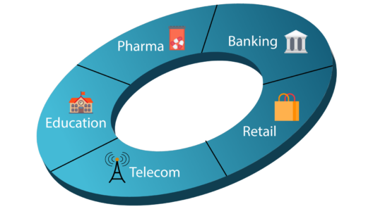
Who uses R?
Telecom
Banking
Finance
Education
Healthcare,etc

Slide 11
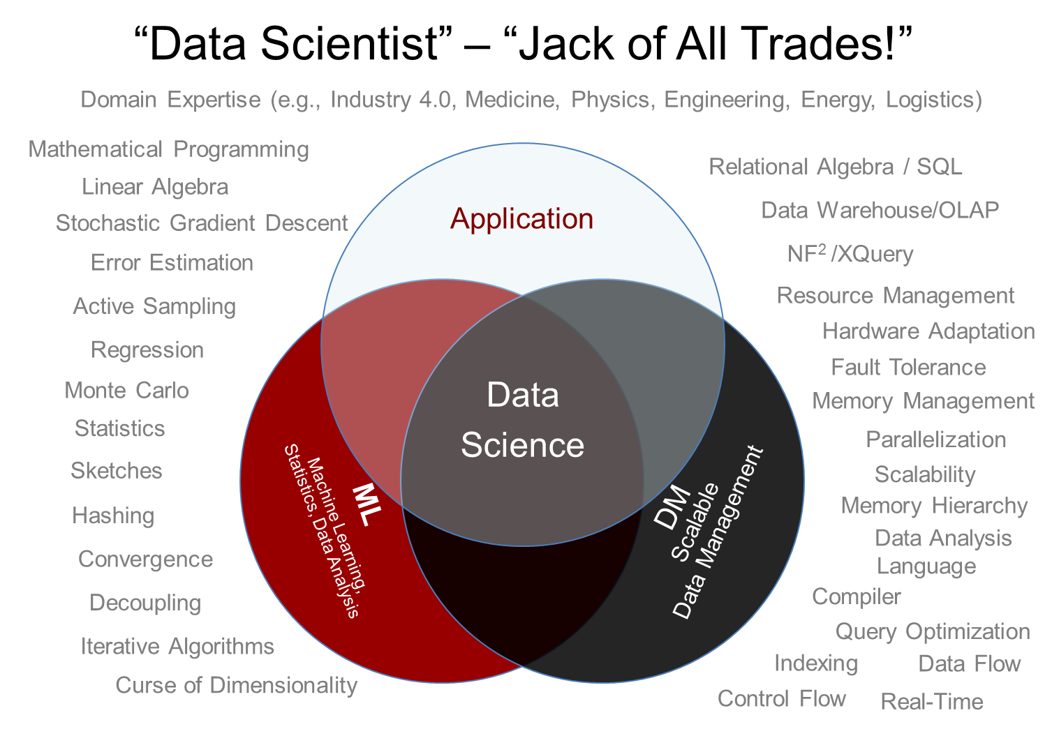
Data Scientist are obsessed with data

Slide 12
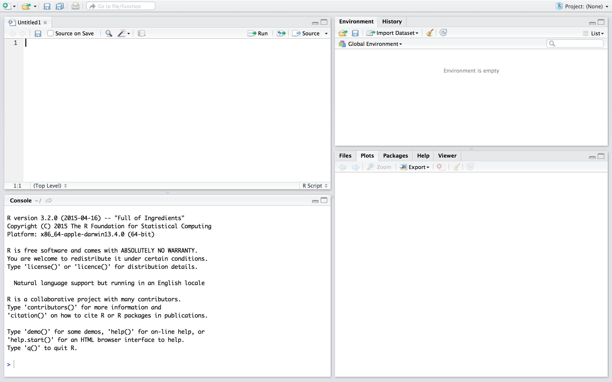
Overview of RStudio

Slide 13
Explore Data using R
A Package is a collection of R functions with comprehensive documents.
A Package includes: R functions, Data Example, Help Files, Namespace and Description.
The default installation is kept as minimum.
The function of R could be extent by loading R packages
Install. Packages(“package name”)
Library(package name)

Slide 14
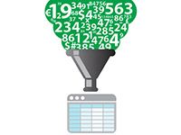
Loading data
Data(dataset name)
read and write functions
Getwd() and setwd()
read and write functions use full path name
Example: a <- read.csv(“c://desktop/sample.csv”)
Assignment operator: “< -”
Help:
help(function name)

Slide 15
Explore Data using R
View first few rows of dataset
head(dataset name) -To get 1st 5 rows display
head(dataset name, 10) - 1st 10 Rows will be display
View last few rows of dataset
Tail (dataset name) - To get Last 5 rows display
Tail(dataset name ,10) -To get Last 10 rows display
Dimensions of dataset:
Dim(dataset name)
nrow(dataset name)
ncol(dataset name)

Slide 16
Explore Data using R
Attribute of data frame
Names(dataset name)
Attributes(dataset name)
View column data:
Dataset$column name
View row data:
dataset name[10:16]
Summarizing data:
summary(dataset) -> mean,median,min,max,IQR
table(dataframe$column)

Slide 17
A few things to known at the outset…..
R is case sensitive, so (Z is a different variable from z)
Be careful with punctuation (e.g “.” vs “,” vs “;”)
Spaces are not allowed (mydata rather than My data)

Slide 18
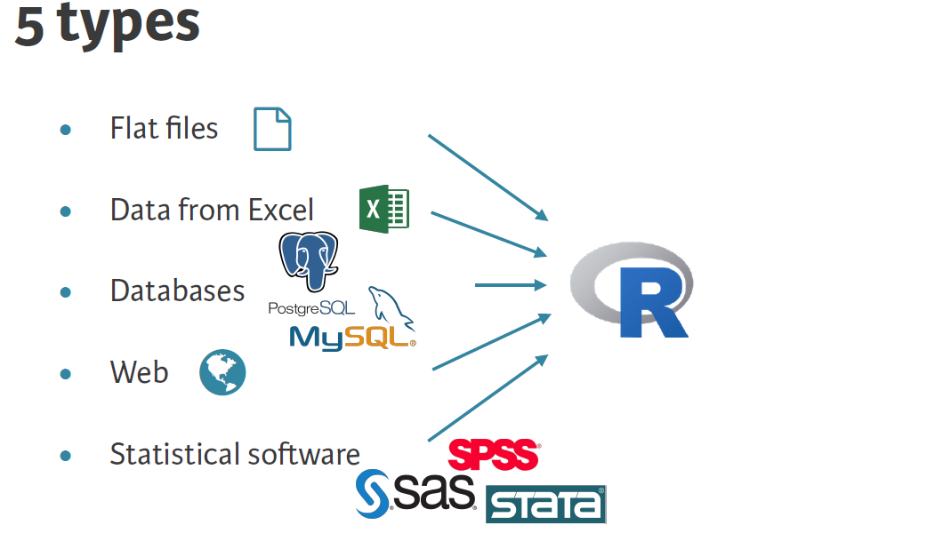
Data Import and Export

Slide 19

How to prepare data for use in R?
The most people interact with data using MS Excel or Open Office Calc.
R works with text files. These are the kind of files created from applications like NotePad (windows), TextWrangler (MAC) or gedit (Linux) and by convention will have the extension .txt
If you have your data in spreadsheet format, it is possible to save it as either a tab-delimited text file or a comma separated text file (csv), R can work with both of these.

Slide 20
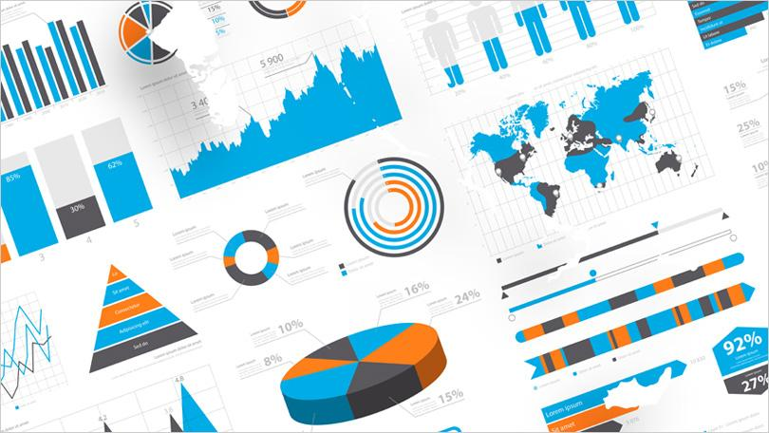
Data Visualization in R:
Different Data visualizations in R:
Basic Visualization
Histogram
Bar / Line Chart
Box plot
Scatter plot
Advanced Visualization
Heat Map
Mosaic Map
Map Visualization
3D Graphs
Correlogram

Slide 21
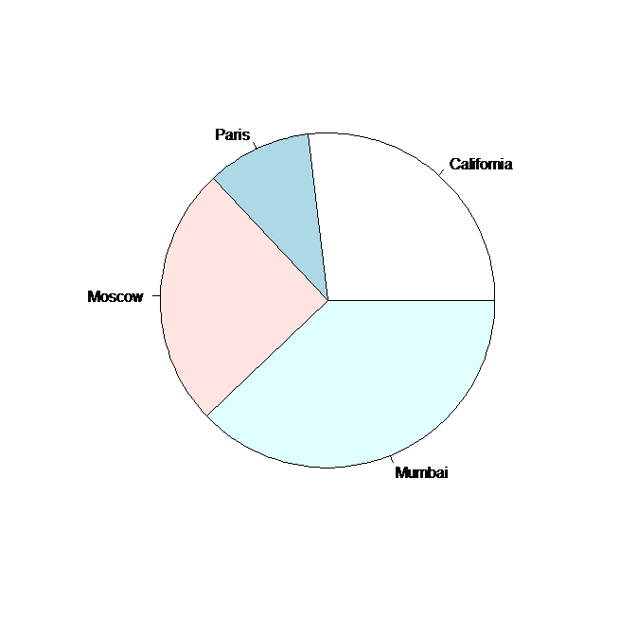
A simple Pie chart in R:
A very simple pie chart is created using just the input vector and labels. The below script will create and save the pie chart
# Create data for the graph.
x <- c(32, 12, 30, 53)
Labels <- c("California", "Paris", "Moscow", "Mumbai")
# Plot the chart
pie(x,labels)
pie(x,labels,main="city_pie_chart",col=rainbow(4))

Slide 22
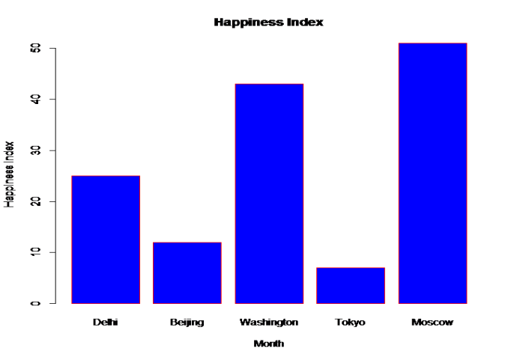
A simple R Bar chart:
A simple bar chart is created using just the input vector and the name of each bar.
H <- c(25,12,43,7,51)
M <- c("Delhi","Beijing","Washington","Tokyo","Moscow")
barplot(H,xlab="Month",ylab="Happiness Index",col="blue",names.arg=M, main="Happiness Index",border="red")

Slide 23
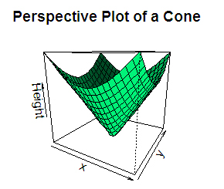
R 3D Plot
persp() function which can be used to create 3D surfaces in perspective view.
x <- y <- seq(-1, 1, length= 20)
z <- outer(x, y, cone)
persp(x, y, z, main="Perspective Plot of a Cone", zlab = "Height",theta = 30,
phi = 15,col = "springgreen", shade = 0.5)

Slide 24
Why R is such a good fit for data analytics are as below
It is an interactive language
It can be used for graphic applications
Statistical programming features
Advanced data visualizations
The data structure
The various R packages
The functions can be used as first class objects.

Slide 25
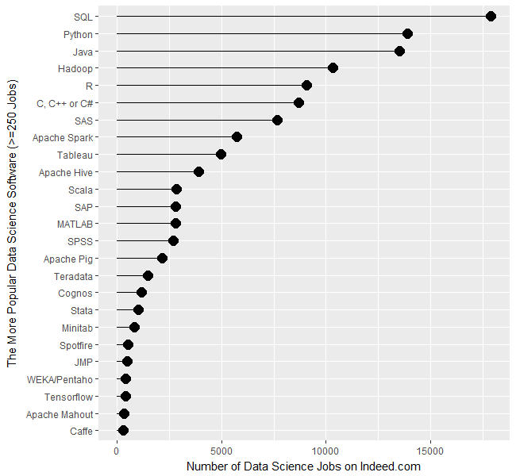
How Popular is R?
User Survey Rexer Analytics Survey 2018 results for data mining/analytic tools.

Slide 26
Features
Open Source:
The source code of R program and the extensions could be examined line by line.
Integrating with other Programming Language:
R is an interpreting language, can be rather slow, but could integrate with high eﬃcient languages such as C, C++ or Fortran.
OS Independence:
UNIX, Linux, Windows, MacOS,
Command line Driven:
You have to write Commands...

Slide 27
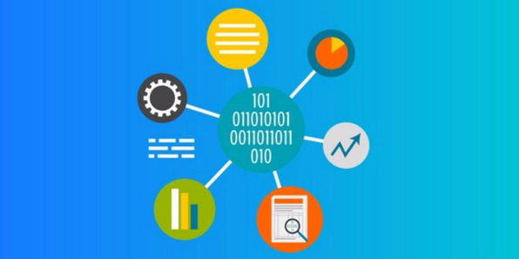
Data Types and Structures
Data types
Integer
Numeric
Character
Factor
Logical
Data structures
Vector
Matrix
Data frame
List

Slide 28
Vector in R
In R, Vector is a basic data structure that contains element of similar type. These data types can be logical, integer, double, character, complex or raw.
The vector is the simplest way to store more than one value in R.
X <- c(1,-2,5.3,6,-20,4) # numeric vector
print(X)
Y <- c("one","two","three") # character vector
print(Y)

Slide 29
Lists
Lists provide a way to store a variety of objects of possibly varying modes in a single R object.
# Create a list.
list1 <- list(c(2,5,3),21.3,sin)
# Print the list.
print(list1)
Result
[[1]] [1] 2 5 3
[[2]] [1] 21.3
[[3]]function(x).Primitive("sin")

Slide 30
Matrices
Matrices are Data frames which contain lists of homogeneous data in a tabular format. it can perform arithmetic operations on some elements of the matrix or the whole matrix itself in R.
# Create a matrix.
mymatrix <- matrix(c(1,2,3,5,6,7,9,10,12), nrow=3, ncol=3, byrow=FALSE)
print(mymatrix)
[,1] [,2] [,3]
[1,] 1 5 9
[2,] 2 6 10
[3,] 3 7 12

Slide 31
Arrays
Array in R are similar to matrices but can have more than two dimensions. An array is created using the array() function. It takes vectors as input and uses the values in the dim parameter to create an array.
# Create two vectors of different lengths.
vector1 <- c(5,9,3)
vector2 <- c(10,11,12,13,14,15)
# Take these vectors as input to the array.
result <- array(c(vector1,vector2),dim = c(3,3,2))
print(result)

Slide 32
Factors
Factors in R is a data type used to store categorical variable, which can be either numeric or string. Most important advantage to convert integer or character to factor is, they can be used in statistical modeling where they will be implemented correctly.
factor() is the function used to convert numerical or character variable to factor
# Create a vector.
apple_colors <- c('green','green','yellow','red','red','red','green')
# Create a factor object.
factor_apple <- factor(apple_colors)
# Print the factor.
print(factor_apple)
When we execute the above code, it produces the following result −
[1] green green yellow red red red green

Slide 33
Data Frames
Data frames are tabular data objects. Unlike a matrix in data frame each column can contain different modes of data. The first column can be numeric while the second column can be character and third column can be logical. It is a list of vectors of equal length.
Data Frames are created using the data. Frame() function.
# Create the data frame.
BMI <- data.frame( gender = c("Male", "Male", "Female"), height = c(152, 171.5, 165), weight = c(81,93, 78), Age = c(42,38,26) )
print(BMI)

Slide 34
Typical advanced analytics lifecycle
Prepare: Assemble, cleanse, profile and transform diverse data relevant to the subject.
Model: Use statistical and machine learning algorithms to build classifiers and regression models
Operationalize: Make predictions and visualizations to support business applications
Prepare
Model
Operationalize
Notes:
© 2014 Microsoft Corporation. All rights reserved. MICROSOFT MAKES NO WARRANTIES, EXPRESS, IMPLIED OR STATUTORY, AS TO THE INFORMATION IN THIS PRESENTATION.
07/03/18 09:43:04
34

Slide 35
The Four Transformational Trends
cloud
computing
big
data
2011 ➔ 2017 5x increase
90% of the data in the world today has been created in the last two years alone
data science
open
source
including R, Linux, Hadoop, Python
Universities filling 300,000+ talent gap
Notes:
© 2015 Microsoft Corporation. All rights reserved. Microsoft, Windows, and other product names are or may be registered trademarks and/or trademarks in the U.S. and/or other countries. The information herein is for informational purposes only and represents the current view of Microsoft Corporation as of the date of this presentation. Because Microsoft must respond to changing market conditions, it should not be interpreted to be a commitment on the part of Microsoft, and Microsoft cannot guarantee the accuracy of any information provided after the date of this presentation. MICROSOFT MAKES NO WARRANTIES, EXPRESS, IMPLIED OR STATUTORY, AS TO THE INFORMATION IN THIS PRESENTATION.
07/03/18 09:43:04
35

Slide 36
Types of Data Analytics
focus on the different types of data analytics we encounter in data science:
Descriptive Analytics
Predictive Analytics
Prescriptive Analytics

Slide 37












Predictive Analytics Tools in Market

Slide 38

1. Descriptive: What is happening?
This is the most common of all forms. In business it provides the analyst a view of key metrics and measures within the business.
An examples of this could be a monthly profit and loss statement. Similarly, an analyst could have data on a large population of customers.

Slide 39

2. Predictive: What is likely to happen?
Predictive analytics is all about forecasting. Whether it’s the likelihood of an event happening in future, forecasting a quantifiable amount or estimating a point in time at which something might happen – these are all done through predictive models.
In a world of great uncertainty, being able to predict allows one to make better decisions. Predictive models are some of the most important utilised across a number of fields.

Slide 40

3. Prescriptive: What do I need to do?
The prescriptive model utilises an understanding of what has happened, why it has happened and a variety of “what-might-happen” analysis to help the user determine the best course of action to take.
Prescriptive analysis is typically not just with one individual action, but is in fact a host of other actions.
A good example of this is a traffic application helping you choose the best route home and taking into account the distance of each route, the speed at which one can travel on each road and, crucially, the current traffic constraints.

Slide 41

Interesting R Applications
Econometrics
Finances (e.g. actuar, fPortfolio, financial, etc.)
Machine Learning
Optimization (e.g. Rquadprog, optmix, etc.)
Social Sciences
Spatial (e.g. maps)
Notes:
41

Slide 42



















Examples of Companies Using R
http://www.revolutionanalytics.com/companies-using-r
http://www.r-bloggers.com/airbnb-uses-r-to-scale-data-science/
http://data-informed.com/companies-use-r-compete-data-driven-world/
http://www.r-bloggers.com/companies-using-open-source-r-in-2013/
Sources

Slide 43
Useful Links…
R Project
CRAN
R Packages
Books and Tutorials
http://www.statmethods.net/
R Bloggers
R Journal
R Graphical Manuals

Slide 44
Thank you

